Slide 1

Hash Tables
- Data Structures -
Lecture 5

Slide 2
Topics to Cover
Hash Table Basics
Terminology
Hash Functions
Hash Table Algorithms
Add, Remove, Find

Slide 3
Imagine, if you will, that we need to find something in a very large set of data. there are a couple of different approaches we could take…

Slide 4

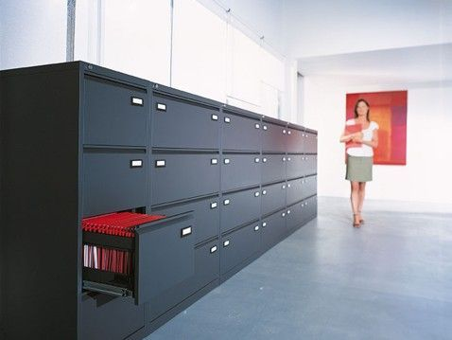

Slide 5
Hash Table Basics
Concept:
Uber-fast Search, Fast Insert & Remove
Is O(1) Search Possible?
(Answer is YES – if done correctly)
Fastest Searches So Far
Array : Sorted O(log₂(N)), Unsorted O(N)
Linked List : O(N)

Slide 6
Hash Table Basics
A Problem
A Large Linked List of Names
Search for ‘Mike B’? O(?)
5000
more
Nodes,
possibly
including
Mike B.
Aaron H
Adam S
Aristotle
Zangief
X
head

Slide 7
Hash Table Concepts
A Simple Hash Table Approach
Search for Mike B.
How is this better?
A | B | C | D | E | F | G | H | I | J | K | L | M | N | O | P | Q | R | S | T | U | V | W | X | Y | Z
Aaron H
Mike B
Zangief
Adam S
X
X
X

Slide 8
Hash Table Concepts
Chaining Hash Table
Bucket (26)
Hash Function
A | B | C | D | E | F | G | H | I | J | K | L | M | N | O | P | Q | R | S | T | U | V | W | X | Y | Z
Aaron H
Mike B
Zangief
Adam S
X
X
int hash (const string &name)
{
return (tolower (name[0])) –‘a’;
}
X

Slide 9
Hash Table Example
const int NUMBUCKETS = 10;
int hash (int &value)
{
return value % NUMBUCKETS;
}
0 | 1 | 2 | 3 | 4 | 5 | 6 | 7 | 8 | 9
X
X
X
X
X
X
X
X
X
X

Slide 10
Hash Table Example
const int NUMBUCKETS = 10;
int hash (int &value)
{
return value % NUMBUCKETS;
}
Insert (67)
0 | 1 | 2 | 3 | 4 | 5 | 6 | 7 | 8 | 9
X
X
X
X
X
X
X
67
X
X
X

Slide 11
Hash Table Example
const int NUMBUCKETS = 10;
int hash (int &value)
{
return value % NUMBUCKETS;
}
Insert (67)
Insert (5)
Insert (42)
Insert (100)
0 | 1 | 2 | 3 | 4 | 5 | 6 | 7 | 8 | 9
100
X
42
X
X
5
X
67
X
X
X
X
X
X

Slide 12
Hash Table Example
const int NUMBUCKETS = 10;
int hash (int &value)
{
return value % NUMBUCKETS;
}
Insert (67)
Insert (5)
Insert (42)
Insert (100)
Insert (87)
0 | 1 | 2 | 3 | 4 | 5 | 6 | 7 | 8 | 9
100
X
42
X
X
5
X
87
X
X
67
X
X
X
X

Slide 13
Hash Table Example
const int NUMBUCKETS = 10;
int hash (int &value)
{
return value % NUMBUCKETS;
}
Find (67) -> 2 checks
Find (5) -> 1 check
Find (42) -> 1 check
Find (100)-> 1 check
Find (87) -> 1 check
0 | 1 | 2 | 3 | 4 | 5 | 6 | 7 | 8 | 9
100
X
42
X
X
5
X
87
X
X
67
X
X
X
X

Slide 14
Hash Table Concepts
Hash Tables
Can use any hash function
Use functions that are safe and efficient
No random or static counters in function
Try to spread out the items
Can define any # of buckets
Best memory / time tradeoffs are usually around 3-10 items/bucket. Use singly linked only.
A | B | C | D | E | F | G | H | I | J | K | L | M | N | O | P | Q | R | S | T | U | V | W | X | Y | Z

Slide 15
Hash Table Concepts
Algorithms
Insert
Call Hash Function
Add item to the specified bucket
FindAndRemove
Call Hash Function
Find and Remove item from the specified bucket
Find
Call Hash Function
Lookup item in specified bucket

Slide 16
Hash Table Concepts
Hash Table Performance
Speed
Between O(1) and O(N) for all operations depending on choice of # of buckets and hash function
Good choice = O(1)
Memory Usage
# of buckets * 4 +
# of items * sizeof(Node)
Advantages and Drawbacks
Adv : Fastest Search Times, especially on large data sets
Disadv : NO sorting
Disadv : Memory Usage

Slide 17
Future Topics and Schedule
Day 6 Trees
Binary Trees, Binary Search Trees
Read 18.1-18.3, 19.1

